Slide 1

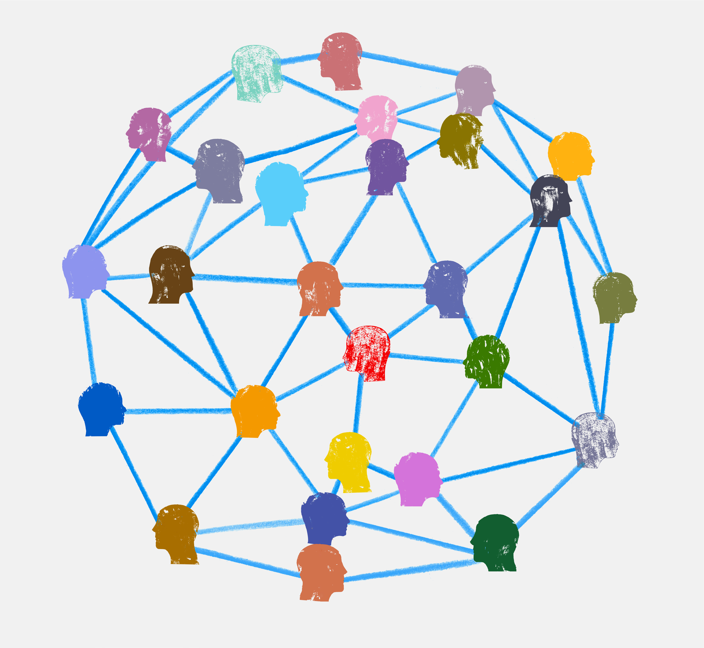
Primary History Network
Session 1: Understanding the History curriculum and maximising pupil progress at each stage

Slide 2

Please try to....
Be present
Participate – use the chat, get on the mic, show us who you are, emoji that response!
Share
Show professional courtesy

Slide 3
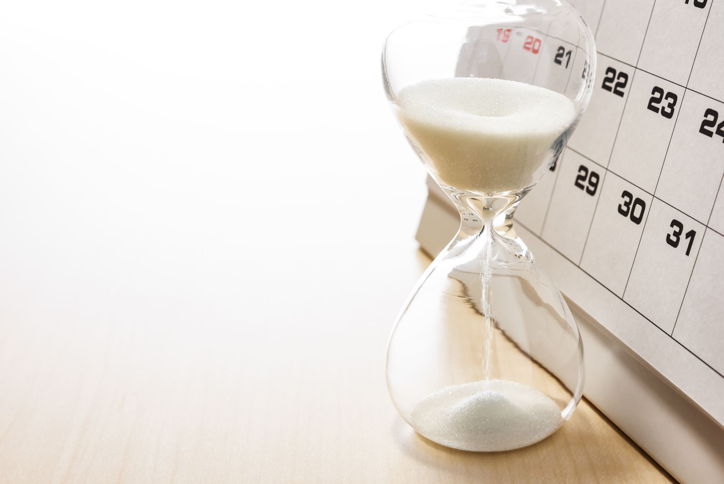
Today's Plan
Opening Prayer
Goals for this group
What is history and why do we teach it?
The History Curriculum: maximising progress to build understanding and skills

Slide 4

Opening Prayer
Dear God
Guide the teachers of history in their teaching. Help them to create an environment where children can learn and grow; and inspire them with the knowledge and understanding of what has gone before them.
Amen

Slide 5



Goals for this group
Mutual support
Sharing experiences and ideas
Confidence
What do you think? Any hopes? Things you would like us to avoid?
If you are brave, turn on your mic / camera to share
Or pop ideas in the chat and we will gather them

Slide 6


Our purpose
What is history?
Why teach history?
The study of past events, particularly in human affairs.
History immerses pupils in unfamiliar worlds, and in the diversity and commonality of human experience across time and place. At the same time, history helps pupils to make sense of their own experiences, and of the world they inhabit.

Slide 7

Our History Curriculum is a joined up and developmental programme
Schools should ensure that:
The curriculum that the school adopts, adapts or constructs identifies the most important content and concepts that can support pupils in future learning, so that teachers can emphasise these in teaching. This is important both in curriculum planning and in teachers’ ‘live’ decisions about emphasis during teaching.

Slide 8
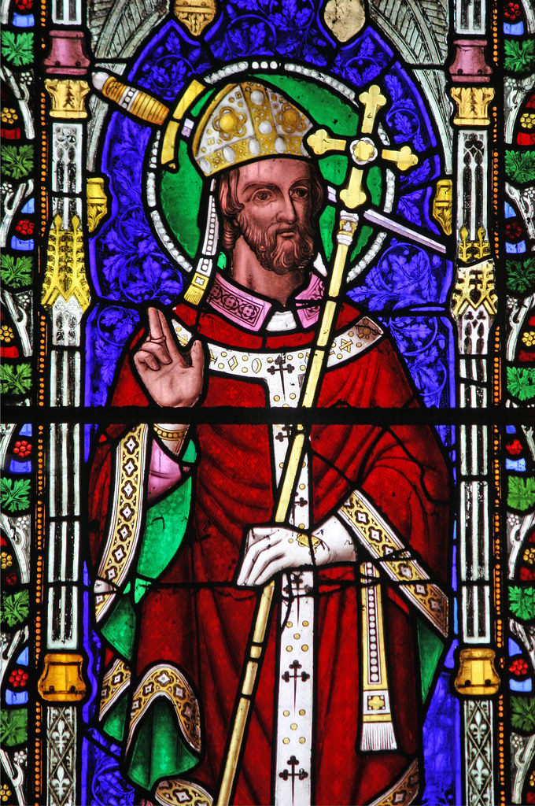
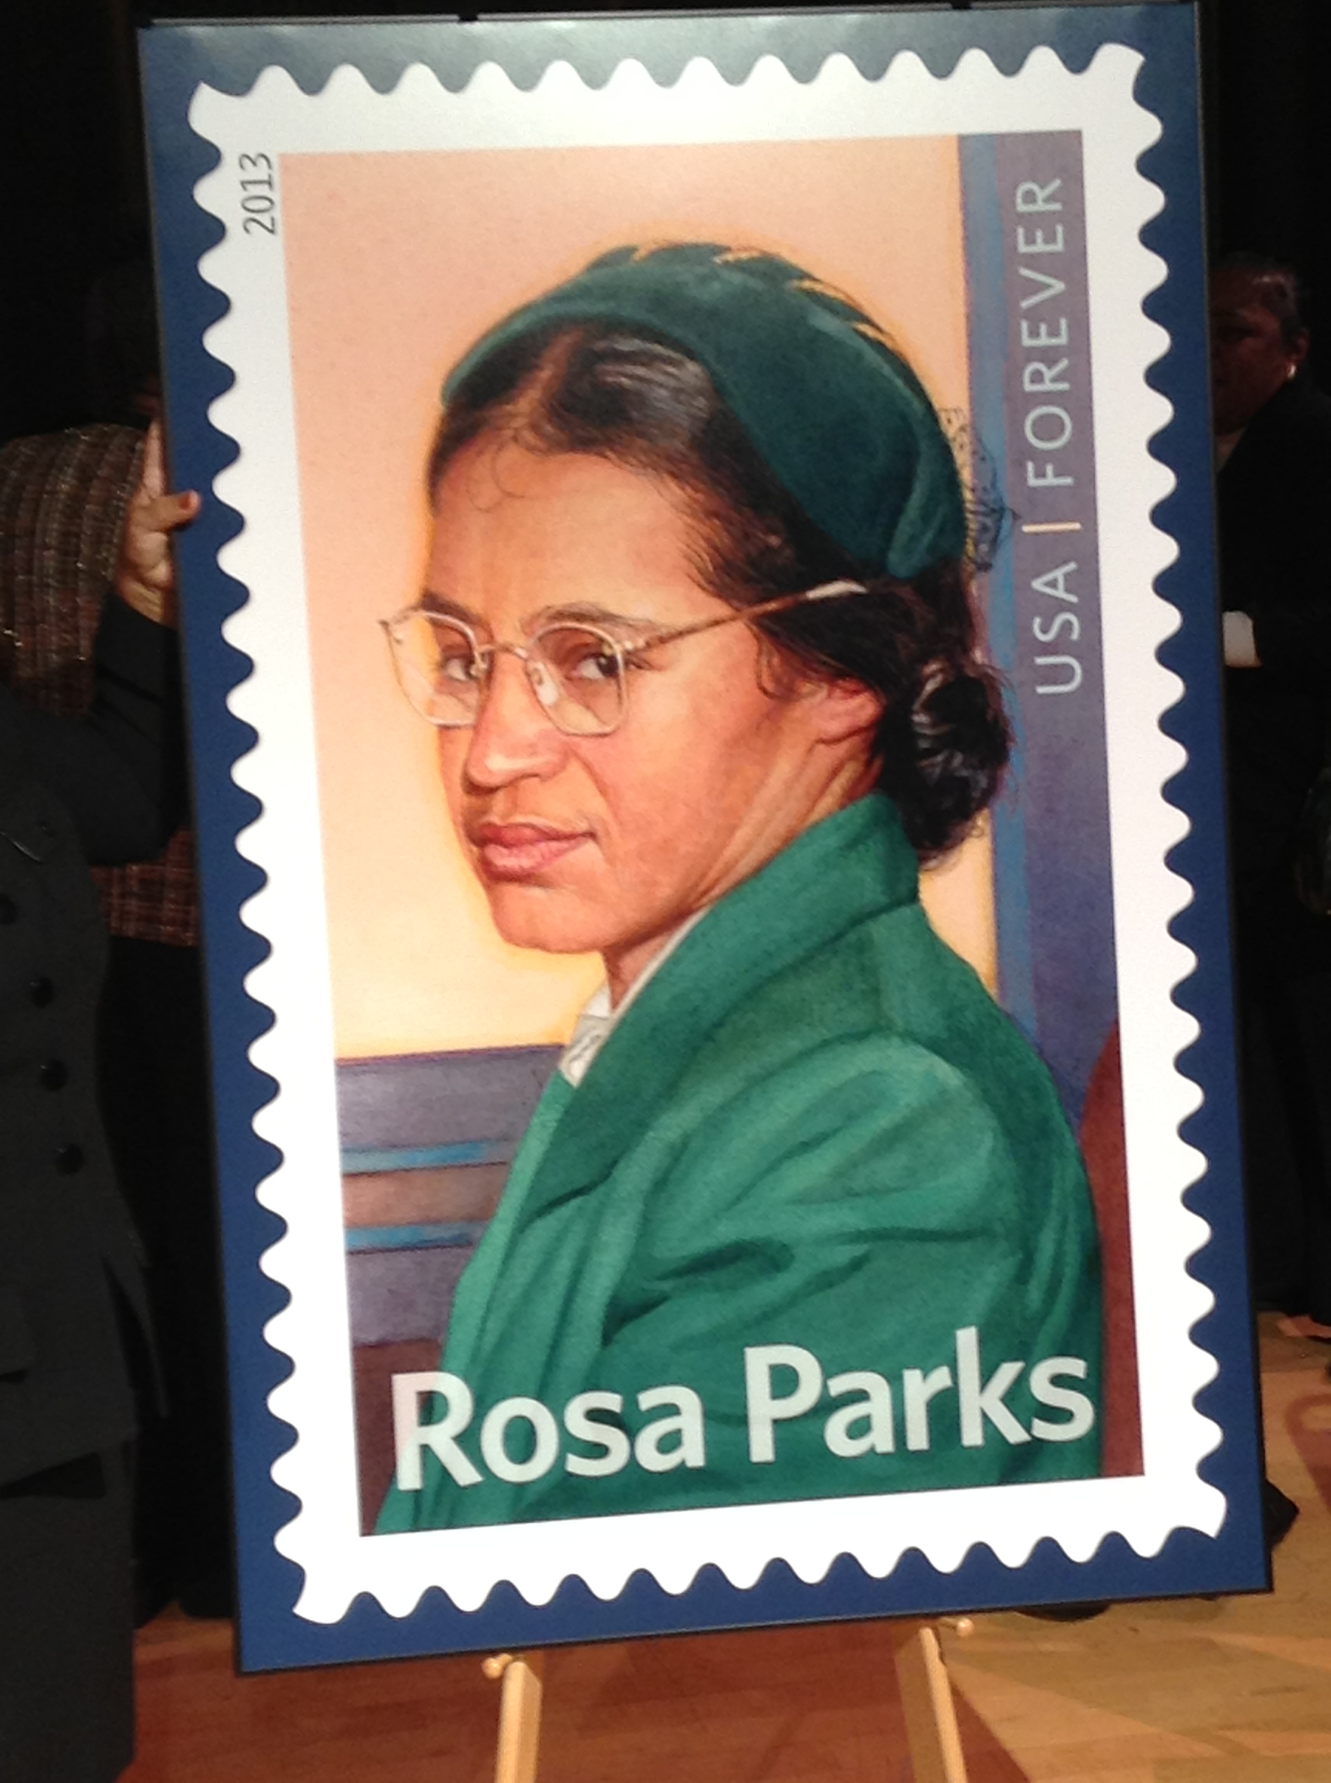
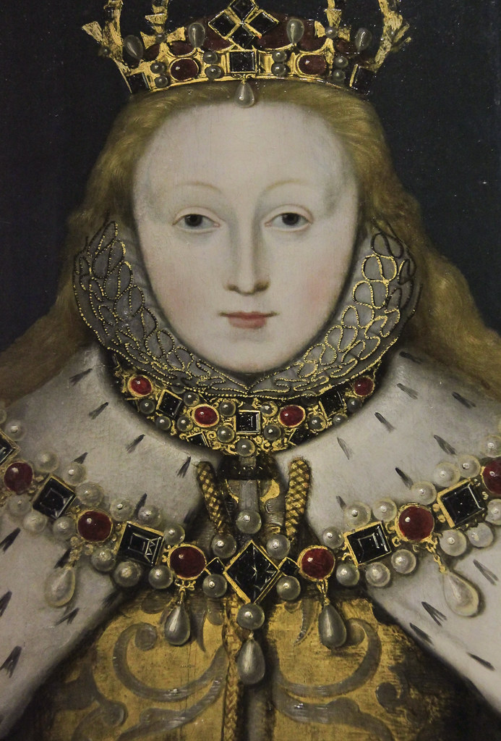
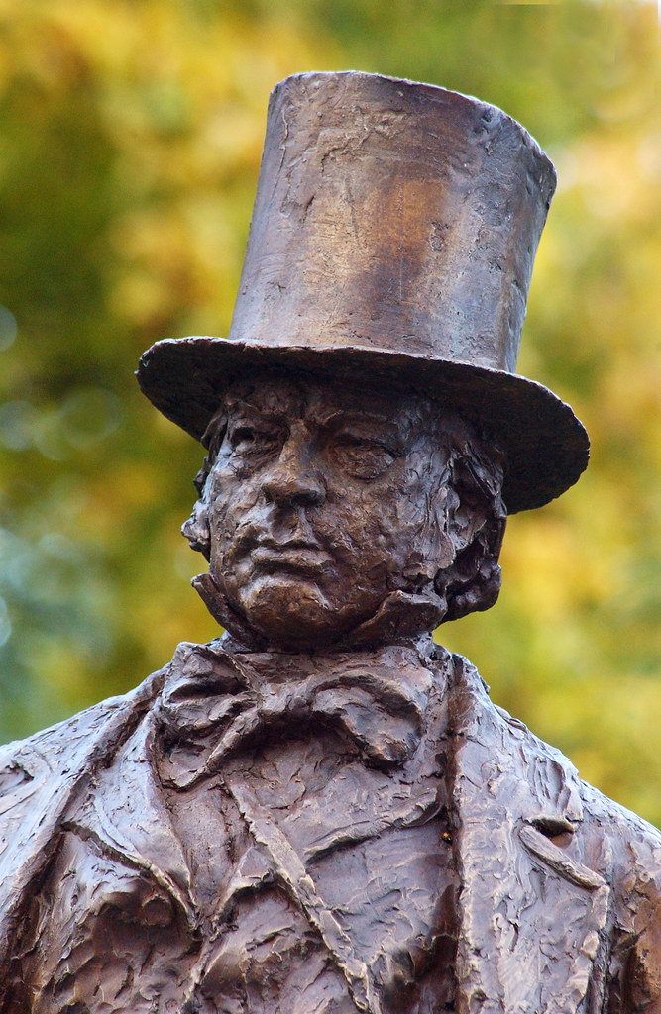
KS1: people, change, significance
Pupils should be taught
changes within living memory.
events beyond living memory that are significant nationally or globally
the lives of significant individuals in the past who have contributed to national & international achievements.
significant historical events, people and places in their own locality

Slide 9
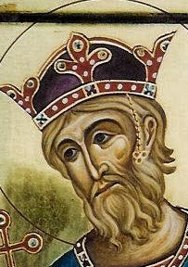
KS2: chronology, links, contrast, sources
PUPILS SHOULD BE TAUGHT ABOUT:
Changes in Britain from The Stone Age to the Iron Age
The Roman Empire and its impact on Britain
Britain's settlement by Anglo Saxons and Scots
The Viking and Anglo-Saxon struggle for England to Edward the Confessor
A local history study
a study of an aspect or theme in British history that extends pupils’ chronological knowledge beyond 1066
Early civilisations / ancient Greece / non-European culture

Slide 10
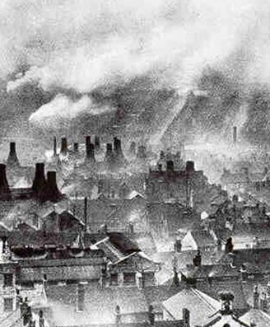
KS3: sustained analysis, historical concepts
Pupils should be taught about:
the development of Church, state and society in Medieval Britain 1066-1509
the development of Church, state and society in Britain 1509-1745
ideas, political power, industry and empire: Britain, 1745-1901
challenges for Britain, Europe and the wider world 1901 to the present day, including the Holocaust
a local history study
the study of an aspect or theme in British history that consolidates and extends pupils’ chronological knowledge from before 1066
at least one study of a significant society or issue in world history

Slide 11

Discussion – how can we make this work?
Chronology – how the numbers go, how we label them (NOT Before Christ and After Death!), orienting events in a chronological framework from KS1. Is making this abstract concept realistic at KS1&2?
Significance – local, national, international. Does the weight of the curriculum allow us to build up the necessary analytical skills?
Sources – as a foundation to understand interpretation and how history is made. What source work do you find most useful?
Local history study – will continue through to GCSE Do we do enough to share so we can build exciting projects at each stage?
ThePhoto by PhotoAuthor is licensed under CCYYSA.

Slide 12

Final thoughts
Was this afternoon useful?
What did you like that we can do more of?
What should we ditch or avoid?
How can we keep up momentum between sessions (if this is what you would like to do)?
Zoe Woodrow, Teacher of History, St Anselm's Catholic School, z.woodrow@st-anselms.org,uk

