Slide 1
Maximising Year 4 MTC outcomes: practical resources & progression
Notes:
For this part we will look at how to use the Ready-to-Progress thinking and practical classroom resources to give Year 4 pupils the best chance in the Multiplication Tables Check. We’ll cover why fluency matters for KS2 outcomes, a clear progression from early years to Year 4, and classroom routines, activities and interventions you can take away and use next week.”

Slide 2
Why times-tables matter for KS2
Automatic recall reduces working memory load
Enables efficient written methods, fractions, scaling and algebraic thinking
Supports reasoning & problem solving across the curriculum
Notes:
“We know times-table fluency is not an end in itself — it frees working memory so pupils can focus on problem solving, strategies, and reasoning in lessons. For example, if a child can recall 7×8 instantly, they don’t have to use effortful calculation when working on fractions, area, or multi-step problems. Fluency underpins many later KS2 objectives.”

Slide 3
Evidence: MTC & later KS2 success
National statistics show attainment and rising average scores (2022–2024).
Research & practitioner analyses: higher MTC fluency generally associated with higher KS2 maths outcomes.
Cambridge Maths Hub / Insight Inform
From “Multiplication tables: from Year 4 to Year 7” (Cambridge Maths Hub). Key findings:
They report a fairly strong positive correlation between Year 4 MTC scores and KS2 Maths SATs scores.
Pupils who scored 19 or above out of 25 on the MTC almost all achieved the expected standard in KS2.
Pupils scoring 13 or below almost none achieved the expected standard. Among those getting full marks in the MTC (25/25), their KS2 scaled scores varied (from 102 to 120), with a mean around 110.
Notes:
What does the evidence say? National statistics show increasing average MTC scores since the check became statutory, and work from researchers and practitioners suggests that higher MTC fluency is associated with greater likelihood of reaching the expected standard in KS2 maths.

Slide 4
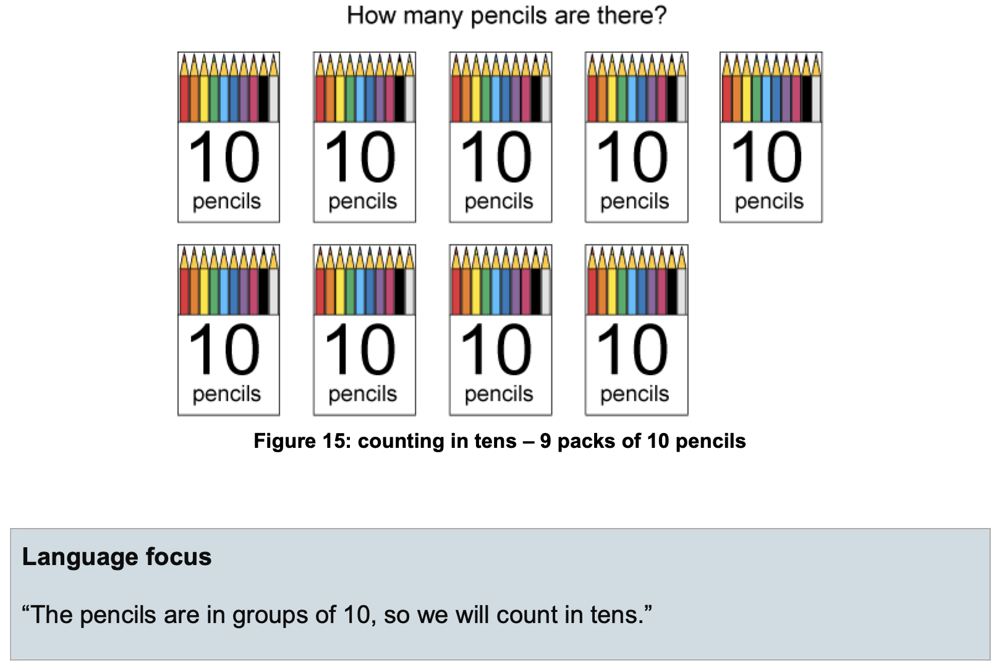
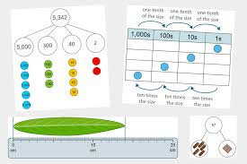
Ready-to-Progress in practice
Secure core skills: grouping, unitising, part–whole
Focus on efficiency: commutativity, distributive thinking
Prioritise core 36 facts as foundation for recall
Notes:
“The Ready-to-Progress criteria are useful because they don’t just list facts — they highlight the skills pupils must master: grouping, unitising, and recognising part–whole structure. In multiplication this means moving children from ‘3 groups of 4’ to seeing ‘4 groups of 3’ (commutativity), and then building distributive thinking, like 7×8 as (7×5) + (7×3). These skills support pupils in learning and applying the 36 core facts, which then unlocks every other table.”

Slide 5
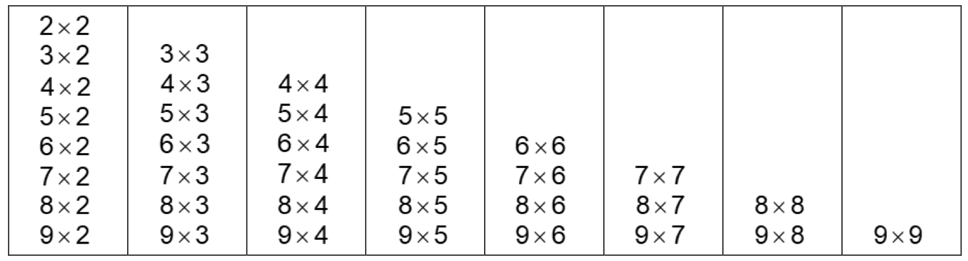
The 36 facts: why they matter
Reduced set: commutativity cuts ~144 facts → 36 key ones
Learn ‘harder’ facts (6s, 7s, 8s, 9s, 12s) through patterns and strategies
Build recall and reasoning: derive, not just chant
Notes:
“By focusing on the 36 essential facts, we cut down the cognitive load for pupils. Facts like 0, 1, 10, and easy 2s or 5s don’t need over-teaching — pupils tend to know them. The teaching time goes to those harder ones: 6s, 7s, 8s, 9s, 12s. The emphasis should be on reasoning — seeing how 9×6 is one less group than 10×6, or that 8×7 is double 4×7. We want children to derive as well as recall, because this builds secure memory.”

Slide 6
The MTC is Not Just a Year 4 Fix
Multiplication fluency is cumulative – the MTC outcome reflects learning from EYFS to Year 4.
Children develop conceptual foundations early: equal groups, sharing, pattern spotting, and language of multiplication/division.
Progression moves from concrete experiences → pictorial models → abstract fluency.
The 36 key facts are a product of years of reasoning, not last-minute practice.
Success depends on embedding multiplicative structures across topics (fractions, scaling, measures, arrays).
Notes:
“The Multiplication Tables Check should never be seen as a quick-fix in Year 4. In fact, it’s the result of consistent multiplicative thinking built up from the earliest years in school.

Slide 7
EYFS & Year 1: building blocks
EYFS:
  Subitising, grouping objects, repeated patterns
  Seeing Patterns such as odds and evens
Year 1:
  Equal groups language (“3 groups of 2”)
  Arrays with counters
  Doubles & repeated addition as early multiplication
Practical ideas:
“Group Hunt” — children sort objects into equal sets
“ “Build an array” with cubes, then flip to see commutativity
Notes:
“Everything starts in EYFS with subitising and grouping — noticing 2s, 5s and 10s in everyday play. In Year 1, we then move to formal language of equal groups, arrays, and early repeated addition. Practical tasks like a ‘group hunt’ — find 3 groups of 2 in the classroom — and using songs and chants for step counting are really powerful. Arrays with cubes or stickers, and then flipping them, introduce commutativity in a concrete way.”

Slide 8
Year 2: bridging to multiplication
Build arrays into structured reasoning
Connect addition ↔ multiplication
Introduce commutativity and early division (sharing & grouping)
Start with 2s, 5s, 10s — then extend to 3s
Practical ideas:
“Fact families”: 3×4 = 12, 4×3 = 12, 12 ÷ 3 = 4
“Cover and reveal”: hide part of an array, pupils deduce missing factor
Skip-counting with bead strings / number lines
Notes:
“Year 2 is about bridging addition into multiplication and starting inverse links. We explicitly teach fact families so children see the structure of multiplication and division. Using arrays, we can hide a part and ask ‘what’s missing?’, which develops multiplicative reasoning. Bead strings and number lines support skip-counting and recognising repeated structures.”

Slide 9
“Cover and reveal”: hide part of an array, pupils deduce missing factor
“What do you see?”
“How many groups of 5 are showing?”
“If there are 6 groups of 5 in total, and I can only see 4 of them, how many are hidden?”
“So what is the missing factor in 5 × ? = 30?”

Slide 10
Year 3: reasoning with multiplication
Secure recall of 2, 3, 4, 5, 8, 10
Develop distributive law (e.g. 7×6 as 7×5 + 7×1)
Introduce scaling (“3 times as tall”)
Move from concrete arrays to abstract recall
“Break it apart”: solve 9×6 by splitting to 9×5 + 9×1
Bar models to show scaling problems
Flashback 4 — daily retrieval including one derived fact
Notes:
“In Year 3, pupils go beyond arrays into distributive reasoning: breaking facts down into easier chunks. For example, 9×6 can be restructured as 9×5 plus 9×1. We also introduce scaling problems — ‘this model is 3 times taller than the original’ — which gives multiplicative context. Retrieval routines like Flashback 4 help embed facts by mixing in a derived fact alongside straightforward recall.”

Slide 11
Year 4: fluency & application
Consolidate recall of all facts up to 12×12
Emphasise the “difficult dozen” (6×7, 7×8, etc.)
Apply to fractions, area, perimeter, scaling problems
Daily short practice + reasoning tasks
Practical ideas:
“Timed MTC-style practice (low-stakes)
Word problems: ‘If one packet has 8 sweets, how many in 7 packets?’
“Distributive Dash”: pupils show two different strategies for same fact
Notes:
“In Year 4, the goal is fluency — but fluency built on reasoning. We focus especially on the difficult dozen facts like 6×7 and 7×8. Use a daily 5–7 minute routine, alternating quickfire retrieval with application. The ‘36 Fact Challenge’ helps pupils see progress, and distributive dash tasks encourage them to show more than one way to solve a fact, strengthening connections.”

Slide 12
The Difficult Dozen
Teach through patterns, derived facts, and connections rather than rote memorisation.
6 × 6 6 × 7 6 × 8
7 × 7 7 × 8 7 × 9
8 × 8 8 × 9 8 × 12
9 × 12 11 × 12 12 × 12
Notes:
“When we look at classroom evidence, not all multiplication facts are equal. The NCETM and Maths Hubs often talk about the ‘Difficult Dozen’ – 12 facts that pupils consistently struggle with. You’ll notice these are clustered around the sixes, sevens, eights, nines and twelves. By strategically focusing teaching and practice on these, we can close gaps and give children the confidence to approach the rest of the table facts. The key is to use reasoning strategies: double three to get six, use near facts like 7 × 8 as one more group than 7 × 7, or link 12 × facts to 10 × and 2 ×. Rather than asking pupils to memorise in isolation, we help them see the structure.”

Slide 13
Distributive Dash
Encourages flexibility and deeper understanding of factors.
Highlights links between known and unknown facts.
7 × 8
(7 × 5) + (7 × 3) = 35 + 21 = 56
(5 × 8) + (2 × 8) = 40 + 16 = 56
Notes:
“Distributive Dash is about pupils realising that there’s more than one way to reach a product. For example, when asked to work out 7 × 8, one child might partition the 7 into 5 and 2, while another partitions the 8 into 5 and 3. Both routes lead to the same answer, but the important learning is that multiplication is flexible — we can decompose numbers in different ways. This activity supports pupils with trickier facts, especially those in the ‘Difficulty Dozen’, because it gives them multiple pathways to recall and check.”

Slide 14
Practical routines & next steps
Daily 6–8 min fluency slot
Mix retrieval + reasoning
Share strategies with parents for practice at home
Notes:
“Finally, keep it practical: a daily 6–8 minute fluency slot is enough, as long as it’s consistent. Mix retrieval and reasoning tasks. And involve parents — share a couple of strategies for games at home, like skip-count clapping or array drawings. That way we build confidence as well as fluency.”

Slide 15

Evaluation
Thank you for taking the time to attend this session.
To enable us to continually improve and develop our CPD provision, please can we ask you to take 5 minutes to complete our feedback form, which you can access here: https://bit.ly/3CxCbf4

